Slide 1
Theory of Computation
CSE 3101
Lecture # 15
Md. Manowarul Islam
Lecturer, Dept of CSE
Jagannath University

Slide 2
Context-free grammar
Notes:
Cpt S 317: Spring 2009
School of EECS, WSU

Slide 3
Simplification of CFG
Many productions in P may not be useful for the purpose of derivation.
It would be better to eliminate (1) variables that do not derive any terminal string and (2) symbols that are not reachable from the start symbol.
If G is a CFG, then we can find an equivalent grammar G’ such that each variable in G’ derives some terminal string.

Slide 4
Eliminating useless symbols
A symbol X is reachable if there exists:
  S ➔* α X β
A symbol X is generating if there exists:
  X ➔* w,
    for some w ∈ T*
For a symbol X to be “useful”, it has to be both reachable and generating
    S ➔* α X β ➔* w’, for some w’ ∈ T*
reachable
generating
Notes:
Cpt S 317: Spring 2009
School of EECS, WSU

Slide 5
Eliminate all symbols that are not generating
Let G=(V_{N}, S ,P,S). We can define G′ =(V′_{N}, Σ ,P′,S) as follows.
a) Construction of V′_{N} :
  We define W_{i} ⊆ V_{N}′ by recursion.
  W₁ = {A ∈ V | there exists a production A →w where w ∈ Σ *}
  W_{i+1}= W_{i} ∪ {A ∈ V | there exists some production A →α
  with α ∈ (Σ ∪ W_{i})*}
  At some point W_{k} = W_{k +1}. Then we get V′_{N} = W_{k}.

Slide 6
Eliminate all symbols that are not generating
Let G=(V_{N}, S ,P,S). We can define G′ =(V′_{N}, Σ ,P′,S) as follows.
b) Construction of P′ :
  P′ ={A →α | A, α ∈ (Σ ∪ V′_{N})*}

Slide 7
Example
S →AB
A → a
B → b
B → C
E → c
Let G:
a) Construction of V′_{N} :
  W₁ ={A,B,E} since A → a, B → b and E → c
  W₂ = W₁ ∪ { A ∈ V_{N} | A →α for some α ∈ (Σ ∪ {A,B,E})*}
  = W₁ ∪ { S}
  = {A,B,E,S}
  W₃ = W₂
  Therefore V′_{N} = {A,B,E,S}

Slide 8
Example
V′_{N} = {A,B,E,S}
b) Construction of P′ :
  P′ ={A →α | A, α ∈ (Σ ∪ V′_{N})*}
  = {S →AB, A → a, B → b, E → c}
Finally G′ Construction of P′ :
S →AB
A → a
B → b
B → C
E → c
S →AB
A → a
B → b
E → c

Slide 9
Example
Let G:
Find the reduced grammar
S →AB|a
A → b
Notes:
Cpt S 317: Spring 2009
School of EECS, WSU

Slide 10
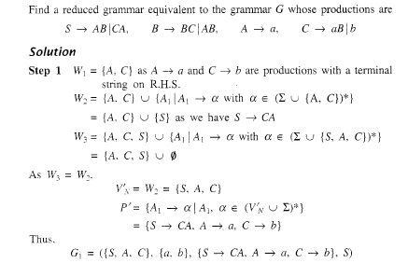

Slide 11
Eliminate all symbols that are not reachable
Let G=(V_{N}, S ,P,S). We can define G′ =(V′_{N}, Σ′ ,P′,S) as follows.
a) Construction of W_{i} for i ≥1
  W_{i} = {S}
  W_{i+1}= W_{i} ∪ { X ∈ (V_{N} ∪ Σ )| there exists a production A →α
  with A ∈ W_{i} and α contain the symbol X}
  At some point W_{k} = W_{k +1}.
b) Construction of V′_{N}, Σ′ ,P′
  V′_{N} = V_{N} ∩W_{k}
  Σ′ = Σ ∪ W_{k}
  P′ = {A →α | A ∈ W_{k}}

Slide 12
Example
S →AB
A → a
B → b
E → c
Let G:
a) Construction of W_{i} :
  W₁ ={S}
  W₂ = W₁ ∪ { X ∈ (V_{N} ∪ Σ )| there exists a production A →α
  with A ∈ W_{i} and α contain the symbol X}
  = {S} ∪ { A,B}
  = {S,A,B}
  W₃ = {S,A,B} ∪ { a,b}
  W₃ = W₄ = {S,A,B ,a,b}

Slide 13
Example
S →AB
A → a
B → b
E → c
W_{k}= {S,A,B ,a,b}
b) Construction of V′_{N}, Σ′ ,P′
  V′_{N} = V_{N} ∩W_{k} ={S,A,B,E} ∩ { S, A,B}= { S, A,B}
  Σ′ = {a,b}
  P′ = {S →AB, A → a, B → b}
Finally G′ :
S →AB
A → a
B → b

Slide 14
Example
Let G:
Find the reduced grammar
S →AB|a
A → b
Notes:
Cpt S 317: Spring 2009
School of EECS, WSU

Slide 15
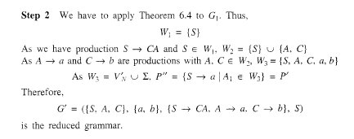

Slide 16
Algorithm to detect useless symbols
First, eliminate all symbols that are not generating
Next, eliminate all symbols that are not reachable
Notes:
Cpt S 317: Spring 2009
School of EECS, WSU

Slide 17
END

